Slide 1

Project Title- Audio… Steganography
Presented by Rudra Roy

Slide 2
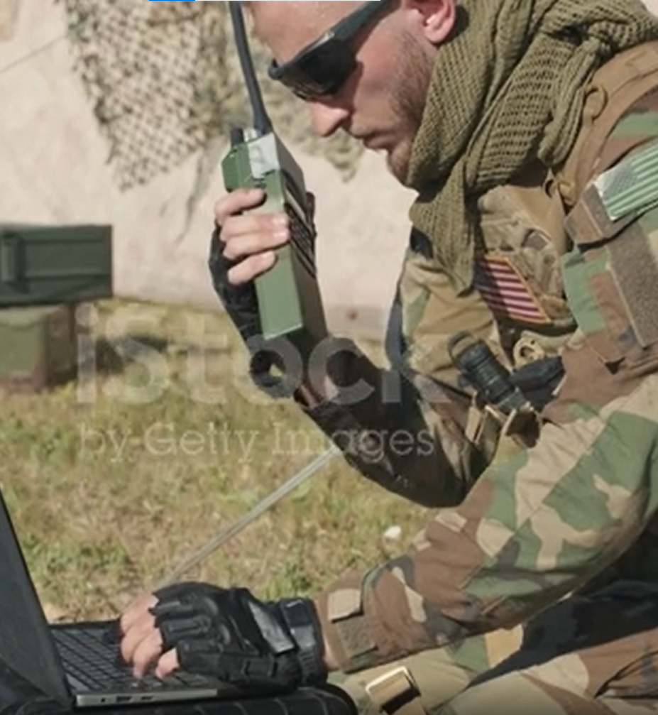
It is very important to send data undetected while a war is running. A simple Info here and there will cost the destruction of a whole country.
During Russia Ukraine war, a lot of intelligence were leaked and these
caused much damage to both countries. So, necessity of sending data secretly is highly understood during war time.
So, it is most likely Putin uses Audio steganography as it is one of the best message sending technique while the war is running.

Slide 3

Advantages of… Audio Steganography
Data Security
Messages do not attract attention. Plainly visible encrypted messages—no matter how unbreakable—will arouse suspicion. Steganography can do this without any suspicion.
Audio Quality
The plots of original audio signal and the message embedded audio signal look almost the same.
Easy to Use
The implementation of this technique is very easy and convenient.

Slide 4
About Our project
LSB Coding Method
Output Figures
SQNR Calculation
Video Demonstration

Slide 5
LSB Coding Method
At first, we have read the audio file.
Then, we have extracted the bits from the audio file.
Dec2bin function doesn’t work with negative values. So, we saved the location of the negative double values and convert them as they are positive then process the file. Later using the negative location, we can construct the audio.
After that, we read the text files and extracted the bits from them.
We have used unicode2native function to do this.

Slide 6
LSB Coding Method (Continued)..
Then we have embedded the string bits with sound bits.
We have checked whether the string is too long to hide in the media file.
We have determined the end of the string by using “\” in the end.
We have reconstructed sound using bin2dec function
We have built the audio file where the message is hidden inside.
We have extracted the message from it and found that it matches with the original message.

Slide 7
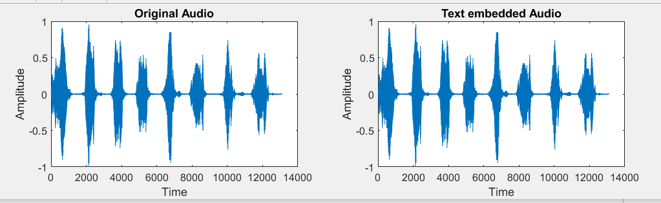
Output Figures..

Slide 8
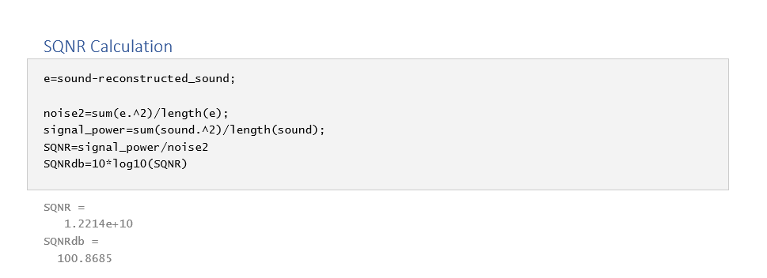
SQNR Calculation
Here we have considered the difference between the original sound and the reconstructed sound as the noise.

Slide 9
SQNR Calculation
Here we have considered the difference between the original sound and the reconstructed sound as the noise.

Slide 10
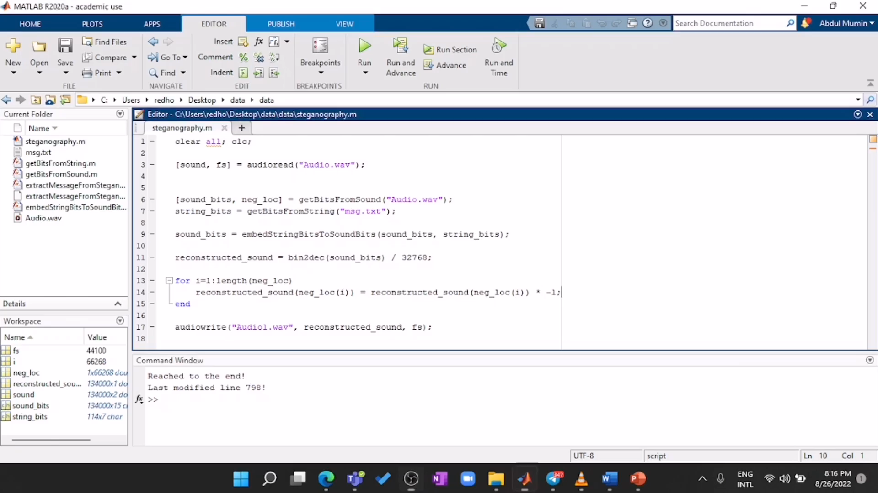
Video Demonstration

Slide 11
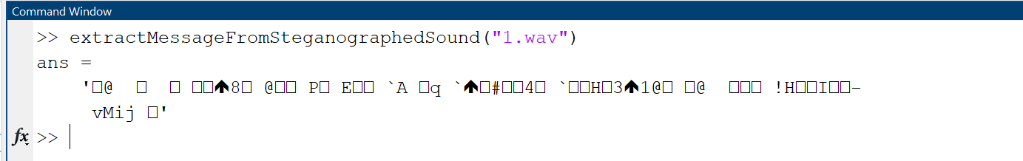
If the message isn’t in the audio file, then the output is some combination of some random characters.

Slide 12
Conclusion
For secure data transmission we will recommend audio steganography. Since there are lot of advantages like easy to implement, very high data security and the audio quality is also very good which we have shown by calculating SQNR. We have also shown a practical demonstration in WhatsApp to verify our claims. We have shown that the message was recovered successfully in the receiving end.
To contact with us regarding this project,
please email at : 1806073@eee.buet.ac.bd

Slide 13
Thank you
Any Questions?

